Slide 1
IRCC’s account and secure space ecosystem
A labyrinth for users to navigate
March 2026

Slide 2
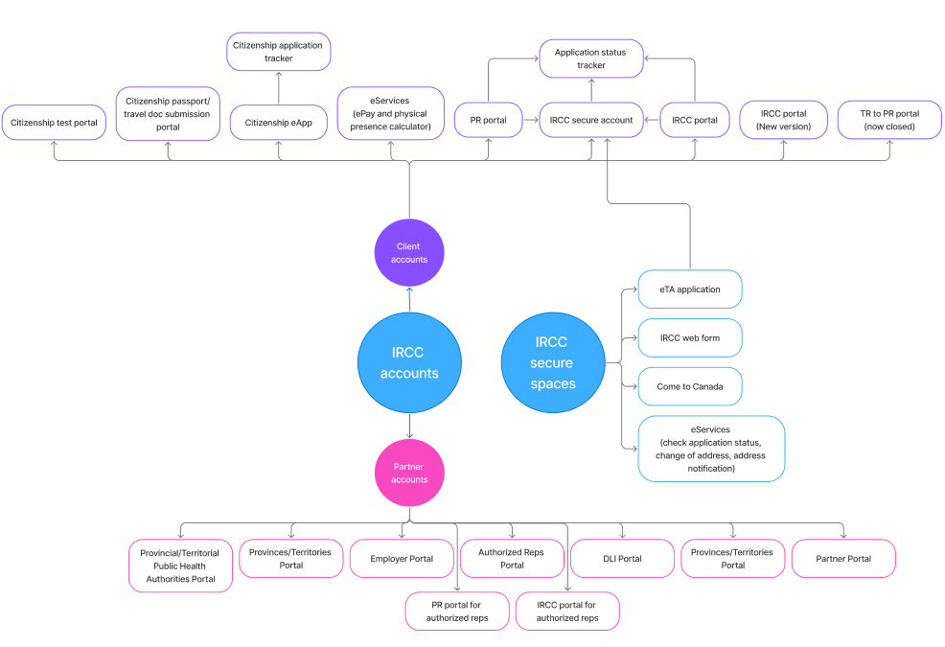




The scale of the problem
11
user accounts
3
rep accounts
6
partner accounts
6+
secure spaces
Account = authenticated space you sign in to
Secure space = authenticated space with no sign in

Slide 3
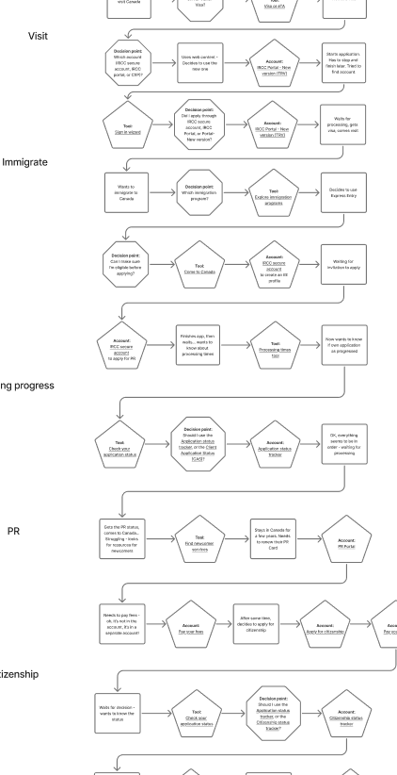
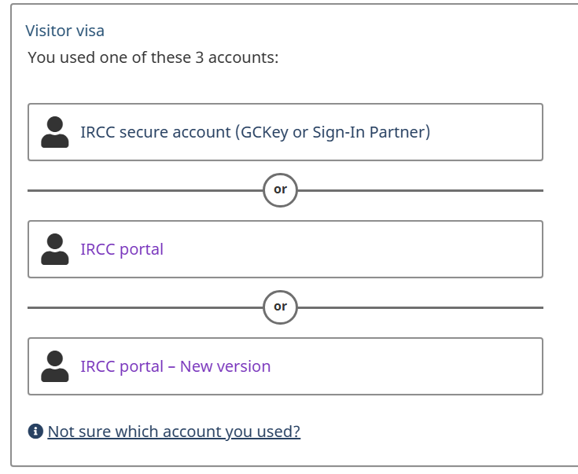
A user’s journey from visitor to citizen
On the journey from visitor to citizen, a single user:
can encounter 19+ different accounts, secure spaces and tools
has to choose between 3 different accounts for their first step (visiting)
may need up to 9 different accounts to complete and track their applications
Full hypothetical journey

Slide 4
Since Digital Platform Modernization 3 started
We added:
2 accounts (CXP-TRV and CXP-PPT)
1 sign-in wizard (to help users find their account)
1 program finder (because Come to Canada is outdated)
We removed:
0
No accounts decommissioned.
No secure spaces or tools retired.
With legacy accounts still available users stick to what they know:
50%
TRV applications submitted in
IRCC secure account
46%
TRV applications submitted in
IRCC portal
4%
TRV applications submitted in
CXP (IRCC portal – new version)
* Data for all of 2025

Slide 5


What users are still telling us
They’re stuck on our front porch, unsure of which door to pick:
13-17%
of feedback comments tied to account problems and confusion
(March 6-12, 2026)
“
I don’t know whether I have an IRCC account of not. How can I check it.
I forget that I apply from which account its either account r portal
Bonjour! Désolé ça fait longtemps j’arrive pas à connecter à mon compte IRCC
Je cherche quel compte qu’elle dois choicsir pour le parrainage de ma femme
“
“
“
The issue will worsen as processing times increase on some major lines of business.

Slide 6
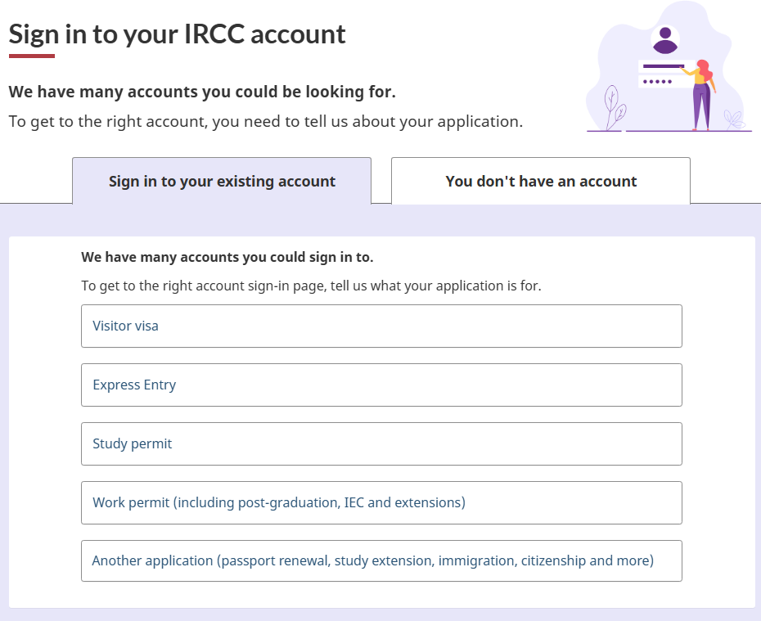

Why Web introduced the account wizard in 2024
Too many paths
With 10 accounts, we can’t easily point users to a single sign-in page
Sometimes multiple valid paths
For visitor visas, users have 3 accounts to choose from, and some types of application can be one in any of the 3 accounts.
Help needed to reduce cognitive load
The account wizard helps users navigate our maze of accounts. But it’s not a solution: It treats the symptom, not the problem.
37.7 million visits to the wizard
(Since September 2024)

Slide 7
The maintenance trap
Legacy accounts in maintenance mode
Department resources shifted to the DPM3 project, leaving bulk of account and secure space needs with a much smaller team.
Department develops new policies/measures
Systems may not all be updated to integrate them, leading to workarounds: creative form answers, different instructions and special codes.
Web band-aids with content
Web communicates these workarounds to users: competing instructions; more to read, understand and remember.
The cognitive load compounds.
1
2
3
Result: More complexity, more choices, more frustration

Slide 8
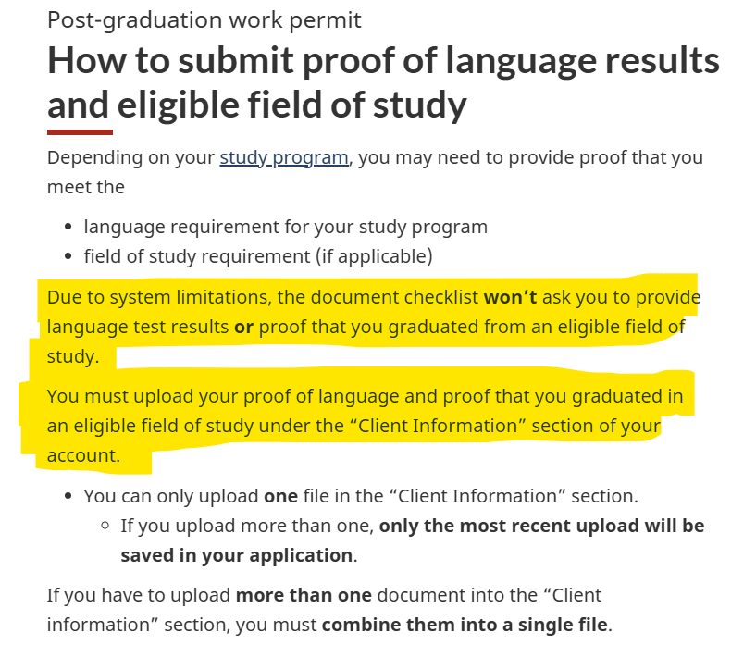
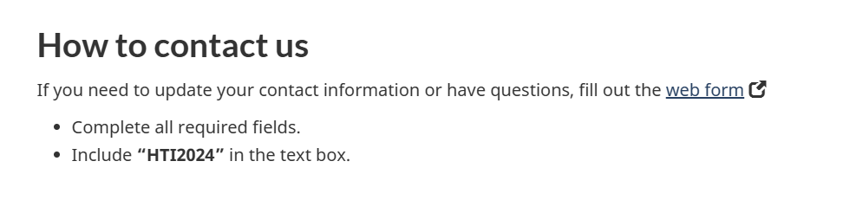
Web band aids: Convoluted instructions in the wrong place
Maintenance mode also prevents us from implementing needed usability improvements.
Web provides instructions to help users complete their task, but not where they actually complete the task. We can’t update those spaces.
The result:
Incomplete applications
Increased frustration
Additional enquiries (web forms, calls, etc.)
The examples on the right are 2 of many workarounds found across most lines of business.
PGWP: System doesn't ask for all required documents
Haiti special measures: special contact code, not found directly in the web form
Workarounds hurt user trust in our web presence.

Slide 9
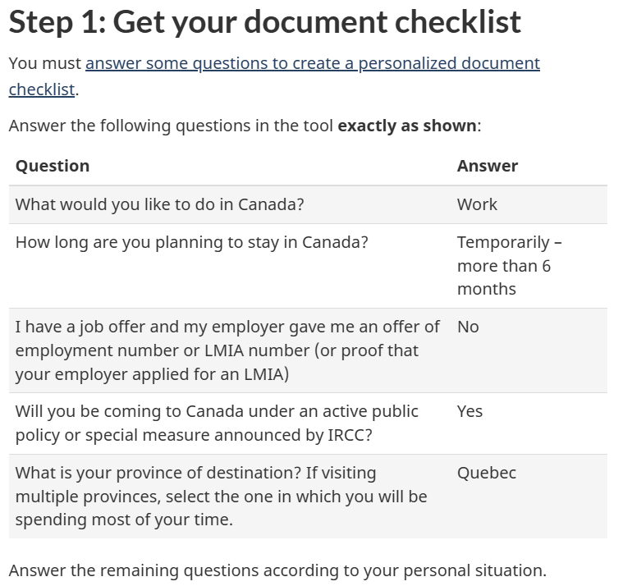
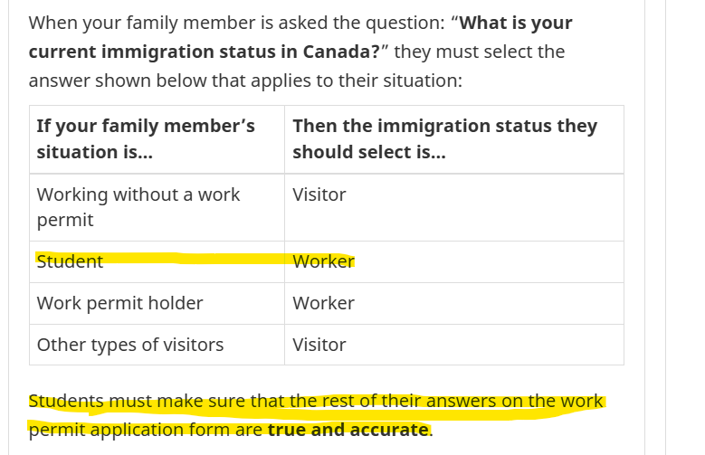
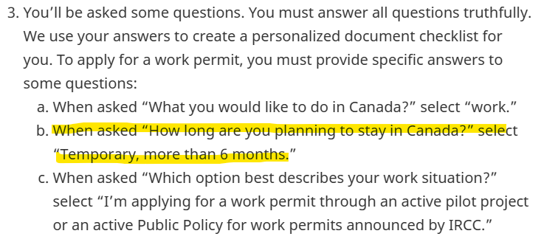
Web band aids: How to answer questions so users get the right application
With C2C outdated (outside of emergency patches), web is left telling users how to answer specific questions, sometimes incorrectly, so they still get the correct application and checklist.
Open work permit for Quebec investors
Open work permit for family members
Applying for a work permit as a PR applicant:
Users expect systems to be up to date. But, instead, we ask them to answer in unintuitive ways, and sometimes to lie, to make an outdated, inaccurate system work properly for them. How can we ask for accuracy and truth from applicants when we start by telling them how to lie to us?

Slide 10
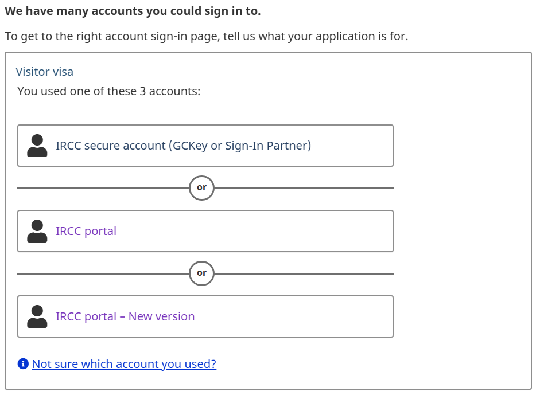
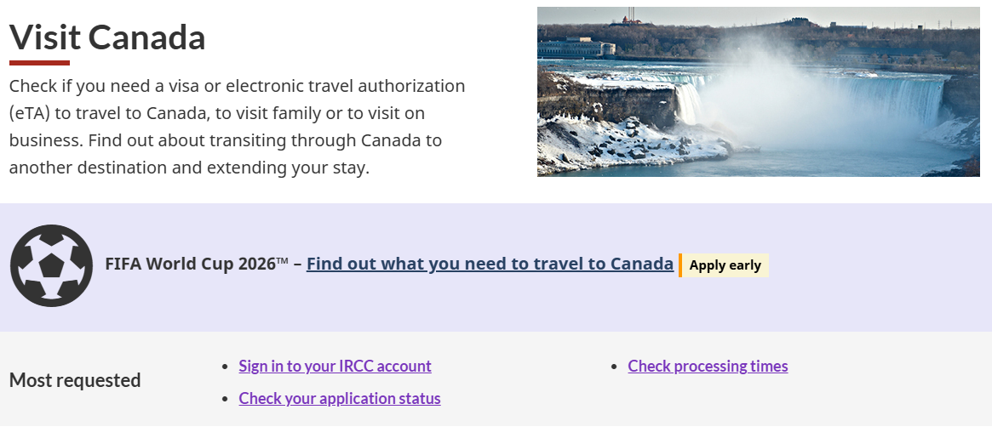
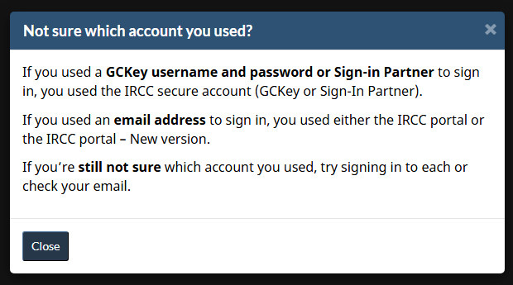
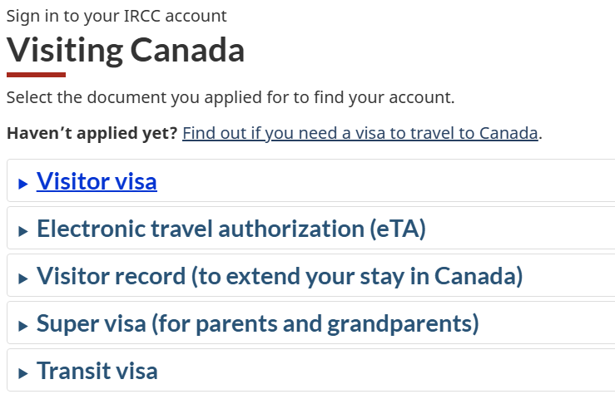
Web band aids: Trying to help users find their account
For some lines of business, we can’t easily point users to the account they used. With it being possible to apply in multiple accounts (across an entire LOB, and even for one application alone), we just don’t know.
Visitor visa: 3 accounts possible, no way to know exactly which was used
Visiting Canada: Account possibilities change depending on what they applied for
Multiple accounts hurt user trust and increase cognitive load. We need to prioritize integrating entire LOBs into the CXP to reduce this burden on users.

Slide 11
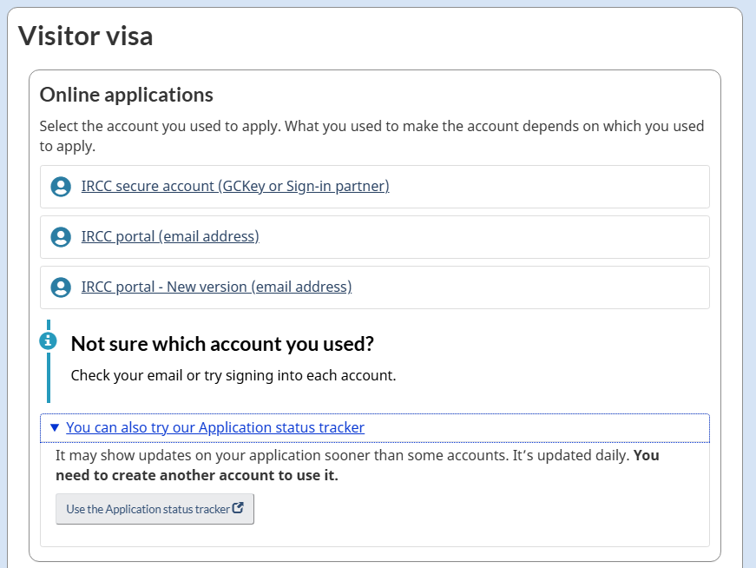
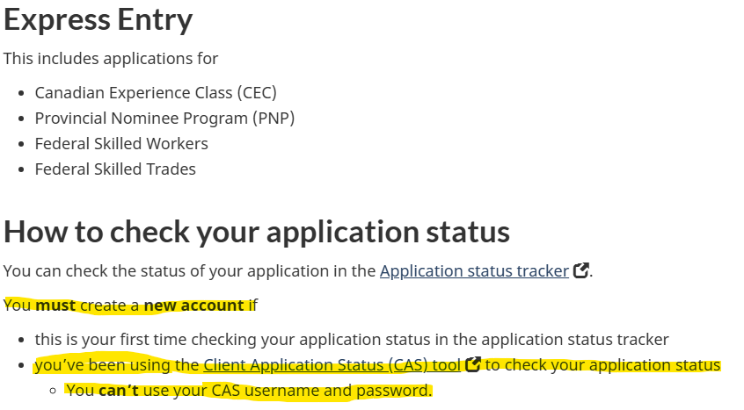
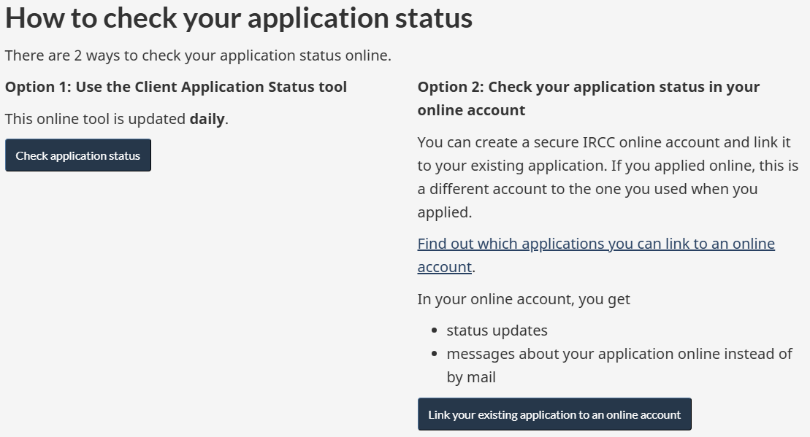
Web band aids: Users try to find where to check their status
Many lines of business now offer multiple places to check application status. Sometimes the user’s account is an option. Sometimes they can also use an entirely different account. Sometimes their original account isn’t even an option.
Visitor visa: 4 accounts, with varying levels of details shared
Express Entry: 2 accounts, but not the one they applied in (which is also an option)
Other PR programs: 2 accounts, but not the one they applied in (which isn’t an option)
Multiple options and no clear idea why one account has something more or different than another.
Which to use: the account you used to apply (if it’s an option), a new account that maybe offers something more, or a different new account with daily updates? Or both? Or all three?

Slide 12
Internal confusion = external challenges
The account sprawl creates internal confusion too.
Ownership is unclear:
It’s difficult to find out who owns an account or tool, and who to contact when there’s a problem.
Capabilities are a mystery:
Teams across the department don’t know or can’t consistently explain what each system does.
Timelines are unknown:
We don’t know how long we’ll be in this interim stage of having multiple accounts that we don’t update.
If we can’t explain it internally, we can't explain it to users.

Slide 13
The strategic path forward
Complete a line of business in the CXP before expanding to new ones
Keep updating legacy accounts—they’re carrying the bulk of applications
Plan CXP program integration strategically to reduce number of accounts and systems
Web tools and web workarounds are not a solution to the complexity. Reduce the complexity itself.
If we follow the current path, we'll keep adding to the confusion.

Slide 14
Slide graveyard

Slide 15
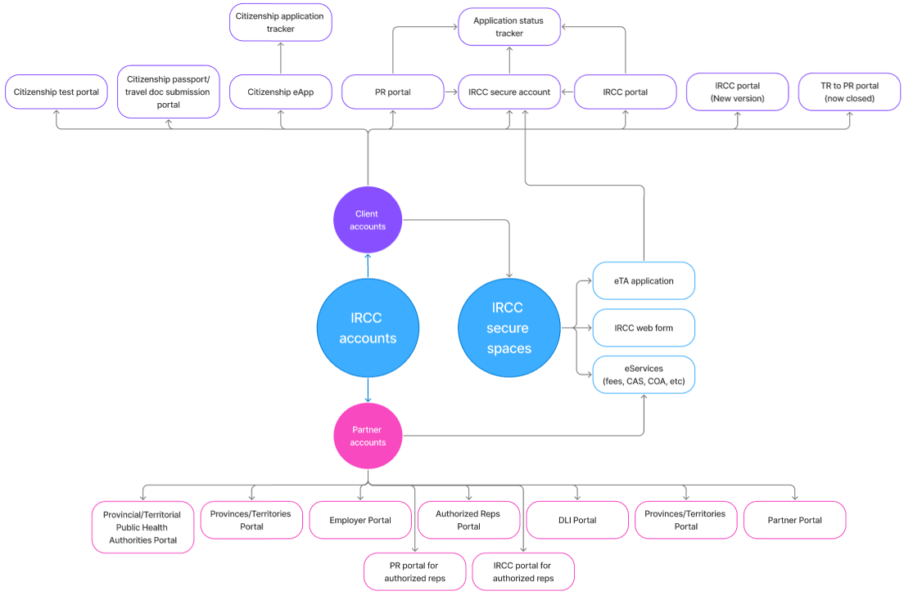
IRCC’s confusing web of accounts and secure spaces
Too many options
10 possible accounts for users
3 accounts for reps
6 accounts for other partners
Multiple accounts possible for same task
Many application-related tasks must be completed outside of account spaces
Multiple accounts or secure tools needed to follow application from submission to decision

Slide 16
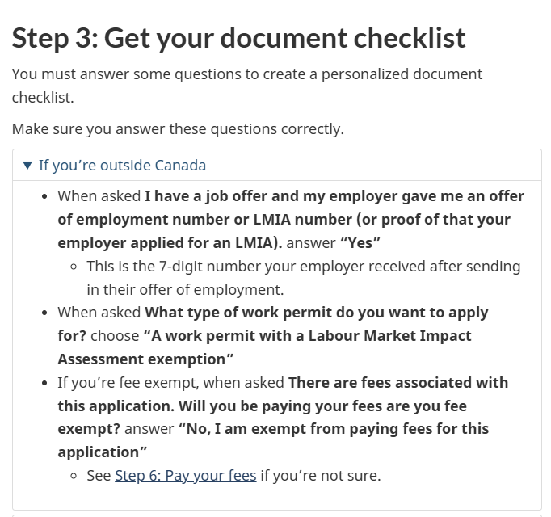
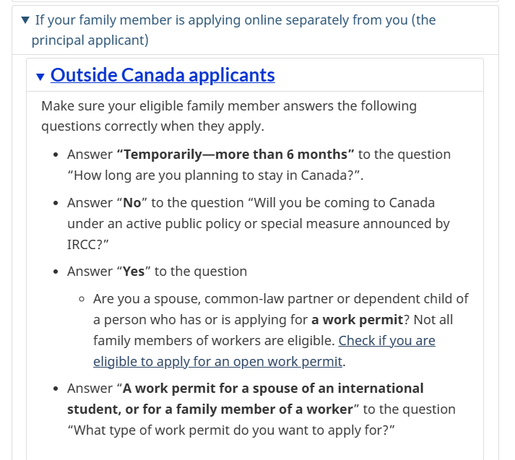
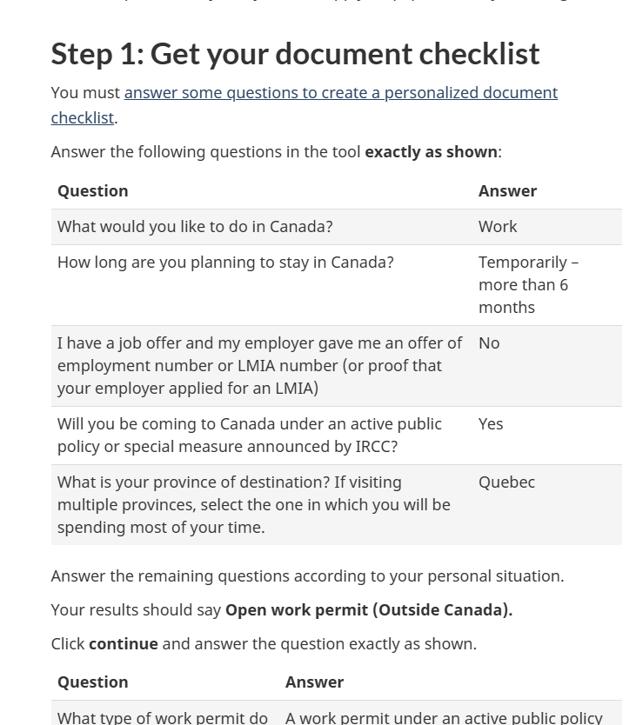
Web band-aids don't solve the issue
Second slide about maintenance trap where we mention?
non-urgent technical problems may not be resolved
client experience and usability updates are not considered
Maybe some visuals of how we communicate workarounds? Work examples below, can find PR ones and web form ones?
This needs a validation check to confirm what maintenance mode does look like (as with previous slide)
https://www.canada.ca/en/immigration-refugees-citizenship/services/work-canada/special-instructions/camp-counsellor/apply.html:
https://www.canada.ca/en/immigration-refugees-citizenship/services/work-canada/special-instructions/spouses-dependent-children/apply.html:
https://www.canada.ca/en/immigration-refugees-citizenship/services/work-canada/special-instructions/quebec-investor/apply.html:

Slide 17
I’m so confused with all these new portals!
I want to sign in to my ircc portal to complete my visit visa application, but I am unable to find login screen, please guide.
Some portals or pages require too many steps to get to.
It’s a feedback loop of itself and impossible to navigate deftly. Where are the submission portals?
It’s so hard to find the login portal
Where is the IRCC portal sign in?
How can I get into my portal

Slide 18
Since Digital Platform Modernization 3 started
CXP is supposed to simplify this experience.
Nearly 2 years in, though:
2 new accounts introduced (TRV and passport)
no existing accounts decommissioned
With no reason to use the CXP and legacy accounts still available, users continue to favour them:
IRCC secure account: 49% of TRV applications
IRCC portal: 46% of TRV applications
CXP: 4% of TRV applications
Image?

Slide 19
Legacy (older) accounts put in maintenance mode
Since CXP’s launch, IRCC’s digital/development arm has placed all older accounts and secure spaces in maintenance mode.
The vast majority of applications are still submitted through these “legacy” accounts.
The Department won’t update them without urgent need.
Image?

Slide 20
Web introduces the account wizard
Users needed help finding their sign-in page:
too many accounts
name of accounts not always known
sign-in pages available only in program content
The account wizard directs them to the account(s) they used for each application.
Since full release in September 2024:
37.7 million visits

Slide 21
Legacy (older) accounts put in maintenance mode
Since CXP’s launch, IRCC placed all older accounts and secure spaces in maintenance mode.
The vast majority of applications are still submitted through these “legacy” accounts, but IRCC won’t update them without urgent need.
This means:
new pilots/programs/special measures may not be properly integrated into secure spaces
non-urgent technical problems may not be resolved
client experience and usability updates are not considered
Image?

Slide 22
CXP contributes to sign-in complexity and frustration
Since CXP launched in 2024:
we now have 3 accounts for visitor visas
no line of business is completed in it
there’s an outage at least once every week
The result: more complexity and more frustration
Image?

Slide 23
Workarounds needed for users
When an account or secure spaces isn’t updated:
program/policy develops workarounds
web communicates them to users
Workarounds can look like:
how to answer questions in Come to Canada to get the right application or document checklist
what to select in the web form if a program isn’t listed, so requests are triaged properly
special codes users need to include so their application or request is flagged as priority (like for special measures)
Image?

Slide 24
Slide title

Slide 26
Issues found with [title/theme here] pages

Slide 27
Web research
Evidence from several sources

Slide 29
Proposed solutions

Slide 30
Quick wins
Easily implementable with no additional testing or research

Slide 31
Moderate wins
Some additional work needed, e.g. content design or testing

Slide 32
Big wins
Complex problems requiring a standalone project effort

Slide 33
Next steps
Moving forward with agility

